Slide 1
Danveer Food Donation App
Name : Anurag Mahada
PRN : 20210801070
Name : Sayali Bhamare
PRN : 20210801114
Name : Abhishek Kokate:
PRN : 20210801068

Slide 2
Abstract
A food donation app is a digital platform created to streamline the process of food donation and connect restaurant owners, administrators, and non-governmental organizations (NGOs) in a collective effort to reduce food waste and help those in need. This abstract outlines the core features of the app and the interactions among the three primary user profiles: restaurant owner, admin, and NGO.
• Restaurant Owner:
Restaurant owners play a pivotal role in the app, initiating the food donation process.
They have the ability to create food donation requests, specifying details about the surplus food they are willing to donate.
• Admin:
Administrators oversee and manage the operational aspects of the app.
Admins maintain control over user accounts, ensuring the platform's smooth operation, and may perform various administrative tasks.
• NGO:
NGOs are vital partners in the food donation process, acting as recipients of donated food.
They can view the food donation requests made by restaurant owners and have the option to accept and claim these requests for distribution.

Slide 3
Introduction
A single restaurant wastes about 1000 pounds of food in a month. Restaurants,
corporate dining rooms, hotels, and other food establishments promptly distribute
perishable and prepared foods to hungry people in their communities. In this
system hotels can provide food to NGO’s by requesting them. NGO’s can also
request hotels when they feel shortage of food. No food waste is the mission of this
system.

Slide 4
Purpose
Many people face starving because of food shortage. Food shortages in
developing countries are common. The people most affected are smallholder. There
are several ways and means to help the needy but nothing works better than making
a contribution to an organization dedicated to helping poor communities to battle
against poverty.
Food is precious for everyone and due to poverty, there are cases where they
couldn’t eat for one time in whole day. On the other side people are wasting food
unknowingly at many places like houses, restaurant, etc. To overcome this problem
instead pf wasting food we can directly handover to the poor people.

Slide 5
Scope
People living in NGO also faces food shortage issues. This application can help
needy people to eat food. With help of this application restaurant can serve food to
many people. NGO’s can also contact restaurants for providing food in shortage of
food. This can feed many poor and needy people.
The app will facilitate the efficient connection between restaurant owners,
NGOs, and administrators for the streamlined donation of surplus food, ensuring
transparency and minimizing food waste.

Slide 6
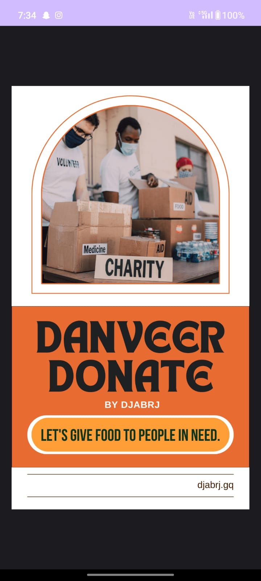
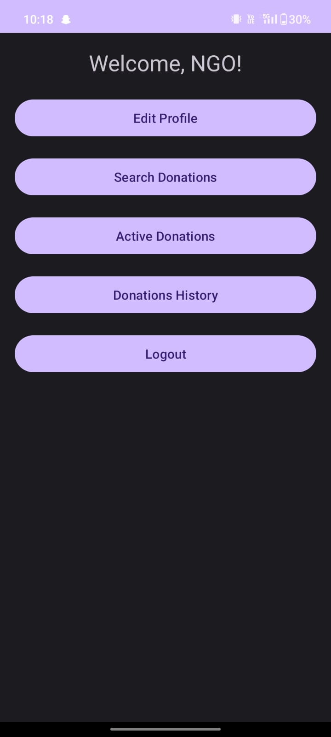
System Design

Slide 7

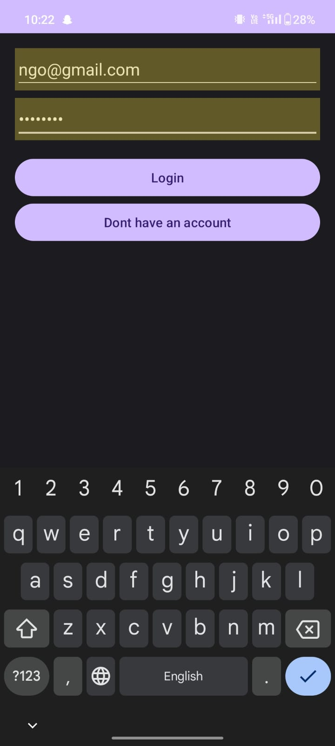
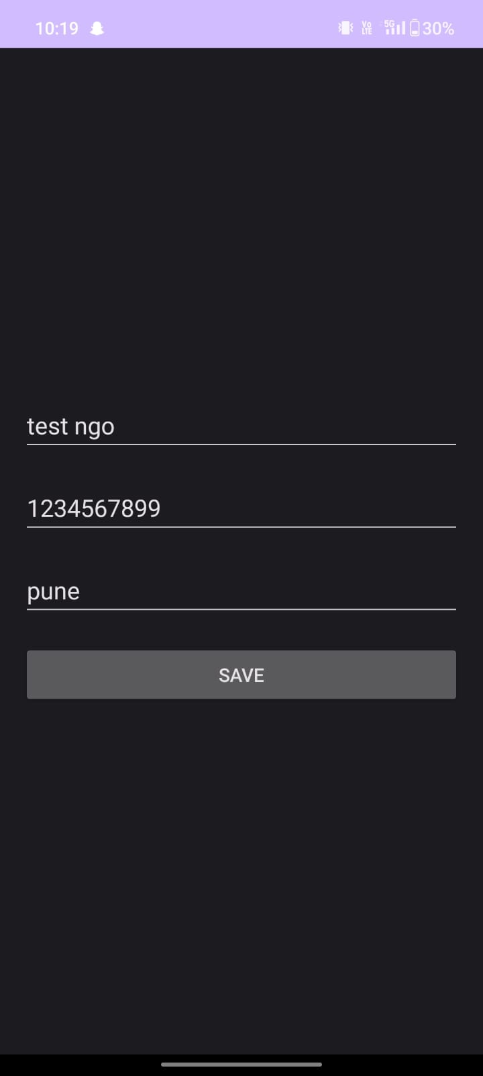
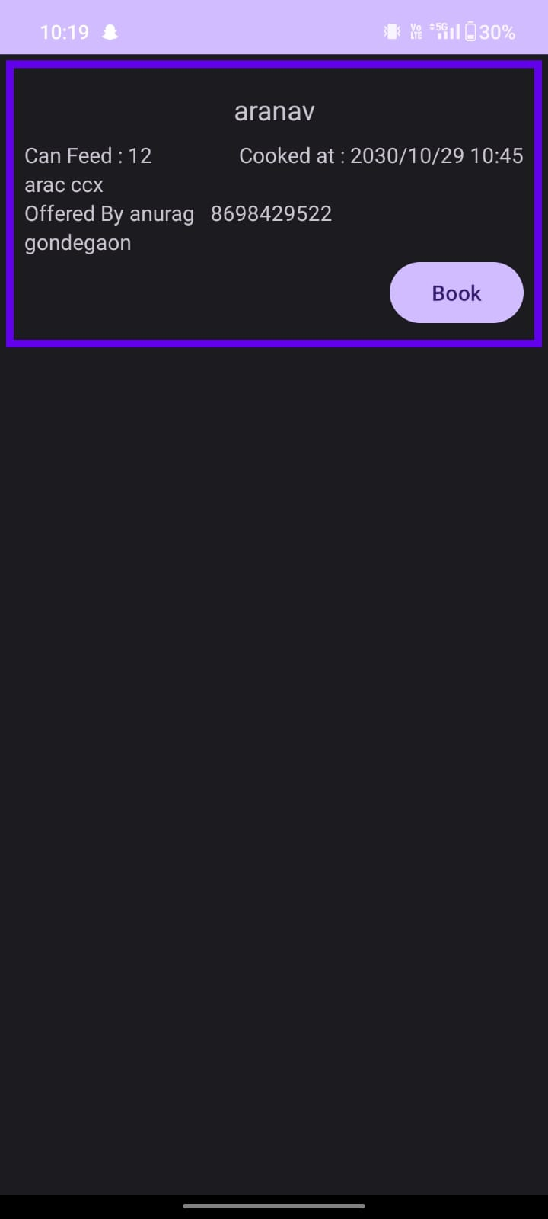

Slide 8
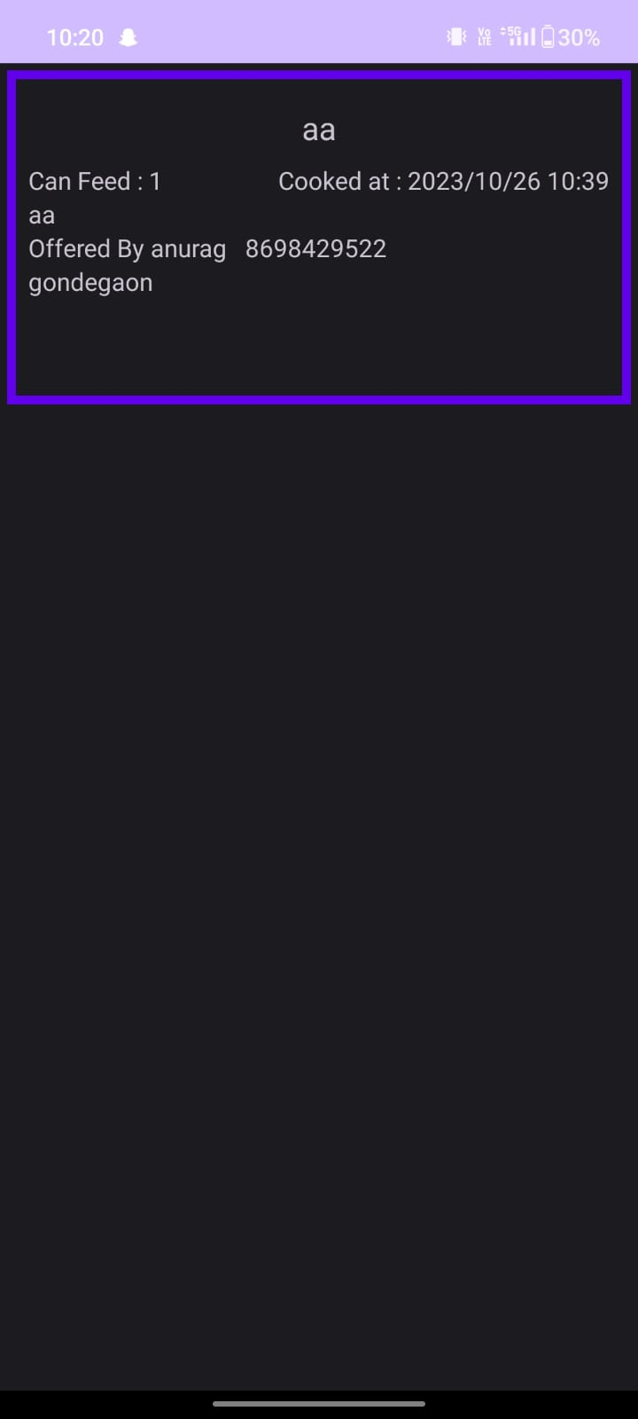
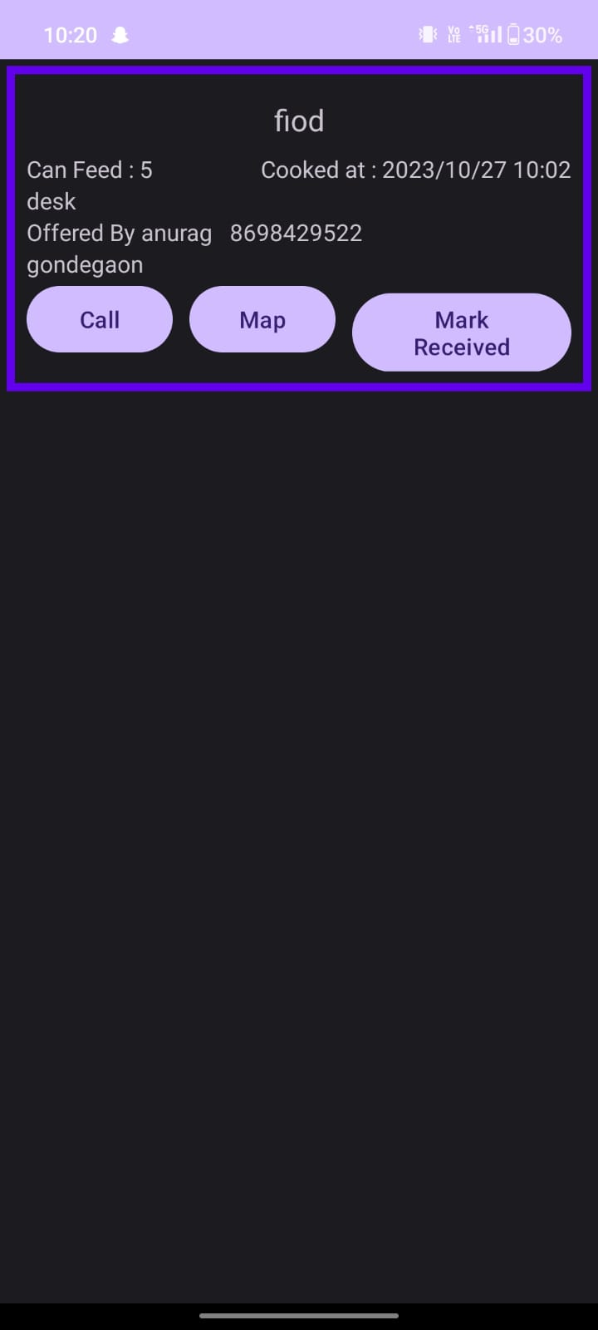

Slide 9
Conclusion
In conclusion, the food donation app is a helpful tool that connects people
willing to share food with those in need. With features like easy sign-up, profile
editing, and a simple donation search, it's user-friendly and accessible.
The goal is to reduce food waste, promote sharing, and create a positive impact
on communities. As the app continues to evolve, user feedback will be crucial in
making it more effective and user-friendly. Overall, it's a step toward building a
more caring and connected community.

Slide 10
Future Scope
•Introduce real-time tracking for active donations, allowing donors and
recipients to track the status and location of donations in transit. Implement
push notifications to keep users updated on the progress of their donations.
•Collaborate with local businesses, restaurants, and event organizers to facilitate
larger-scale food donation initiatives. Enable corporate partnerships for targeted
donation campaigns and events.

